Slide 1
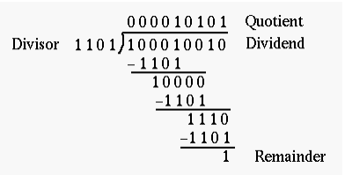
Division Algorithm
Division of two fixed-point binary numbers in signed magnitude representation is performed with paper and pencil by a process of successive compare, shift and subtract operations.
Binary division is much simpler than decimal division because here the quotient digits are either 0 or 1 and there is no need to estimate how many times the dividend or partial remainder fits into the divisor. The division process is described below

Slide 2
The devisor is compared with the five most significant bits of the dividend. Since the 4-bit number is smaller than B, we again repeat the same process.
Now the 5-bit number is greater than B, so we place a 1 for the quotient bit in the 5th position above the dividend.
Now we shift the divisor once to the right and subtract it from the dividend.
The difference is known as a partial remainder because the division could have stopped here to obtain a quotient of 1 and a remainder equal to the partial remainder.
Comparing a partial remainder with the divisor continues the process. If the partial remainder is greater than or equal to the divisor, the quotient bit is equal to 1.
The divisor is then shifted right and subtracted from the partial remainder. If the partial remainder is smaller than the divisor, the quotient bit is 0 and no subtraction I needed. The divisor is shifted once to the right in any case.

Slide 3
Division: Hardware Implementation for Signed-Magnitude Data
In hardware implementation for signed-magnitude data in a digital computer, it is convenient to change the process slightly.
Instead of shifting the divisor to the right, two dividends, or partial remainders, are shifted to the left, thus leaving the two numbers in the required relative position.
Subtraction is achieved by adding A to the 2's complement of B. End carry gives the information about the relative magnitudes.
The hardware required is identical to that of multiplication.
Register EAQ is now shifted to the left with 0 inserted into Qn and the previous value of E is lost.
The divisor is stored in the B register and the double-length dividend is stored in registers A and Q.
The dividend is shifted to the left and the divisor is subtracted by adding its 2's complement value.
The information about the relative magnitude is available in E.

Slide 4
If E = 1, it signifies that A >=B. A quotient bit 1 is inserted into Qn, and the partial remainder is shifted to the left to repeat the process.
If E = 0, it signifies that A < B so the quotient in Qn, remains a 0 (inserted during the shift). The value of B is then added to restore the partial remainder in A to its previous value.
If the shift-left operation inserts a 0 into E, the divisor is subtracted by adding its 2's complement value and the carry is transferred into E .
The partial remainder is shifted to the left and the process is repeated again until all five quotient bits are formed.
After five shift, the quotient is in Q and the final remainder is in A.

Slide 5
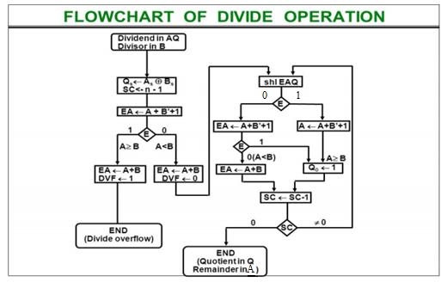

Slide 6
The dividend is in A and Q and the divisor in B . The sign of the result is transferred into Q, to be part of the quotient.
A constant is set into the sequence counter SC to specify the number of bits in the quotient.
A divide-overflow condition is tested by subtracting the divisor in B from half of the bits of the dividend stored in A.
If A >=B, the divide-overflow flip-flop DVF is set and the operation is terminated prematurely.
If A < B, no divide overflow occurs so the value of the dividend is restored by adding B to A .
This process is repeated again with register A holding the partial remainder. After n - 1 times, the quotient magnitude is formed in register Q and the remainder is found in register A .

